Slide 1

Shared-Memory Parallelism: CPUs, GPUs and in-between
Dr. Gal Oren
Yehonatan Fridman
winter 2022-2023

Slide 2
Today’s Outline: Debug & profile & analyze tools
1) oneAPI Debug Tools
What is oneAPI (review)?
Intel® VTune™ Profiler
Intel® Advisor
Intel® Distribution for GDB*
Intel Inspector
See more: Intel® oneAPI Programming Guide - oneAPI Debug Tools
https://www.intel.com/content/www/us/en/develop/documentation/oneapi-programming-guide/top/software-development-process/debugging-the-dpcpp-and-openmp-offload-process/oneapi-debug-tools.html
2) CUDA Toolkit: NVProf

Slide 3

What is oneAPI?
https://www.youtube.com/watch?v=GlmcJTpkpqA&list=PLg-UKERBljNxsCltpcXU_Haz9xQSCN_SB&index=2

Slide 4
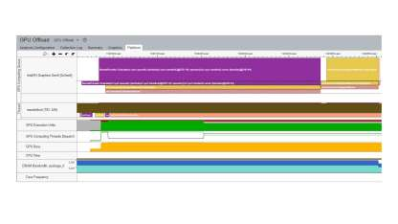
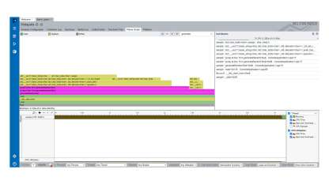
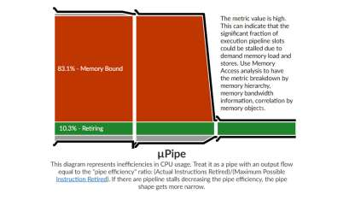
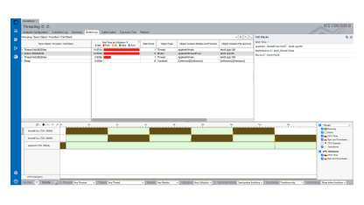
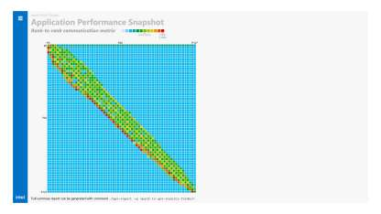
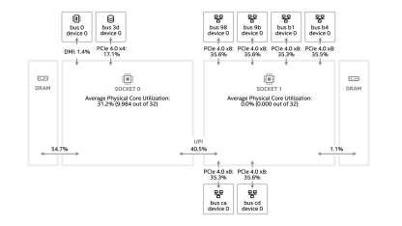
Intel® VTune™ Profiler
Performance Analysis for Applications & Systems
Intel® VTune™ Profiler
Algorithm Optimization
Microarchitecture and Memory Bottlenecks
Accelerators
Parallelism
Platform and I/O
Multi-Node

Slide 5
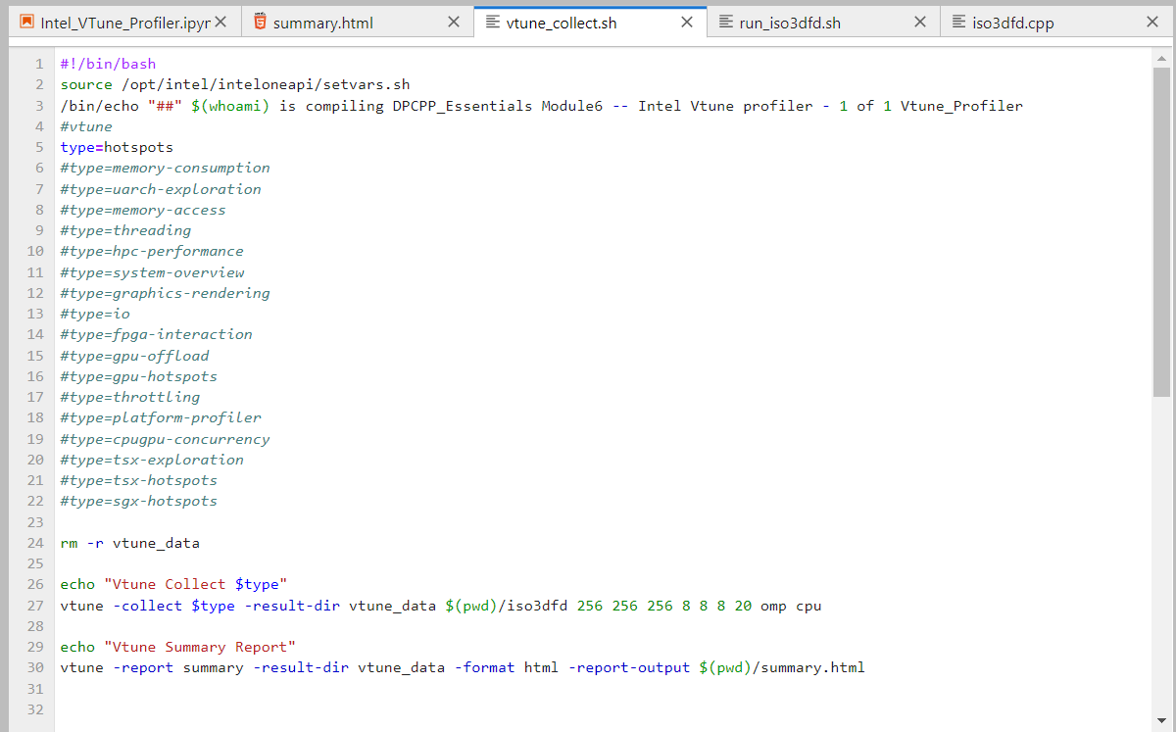
Intel® VTune™ Profiler
Performance Analysis for Applications & Systems
Intel® VTune™ Profiler
Example: 3D Isotropic Acoustic Finite-Difference Wave Equation
Analyze Hotspots:

Slide 6
Intel® VTune™ Profiler
Performance Analysis for Applications & Systems
Intel® VTune™ Profiler
Example: 3D Isotropic Acoustic Finite-Difference Wave Equation
Analyze Hotspots:
click to see the example on a notebook
Click to watch VTune result

Slide 7
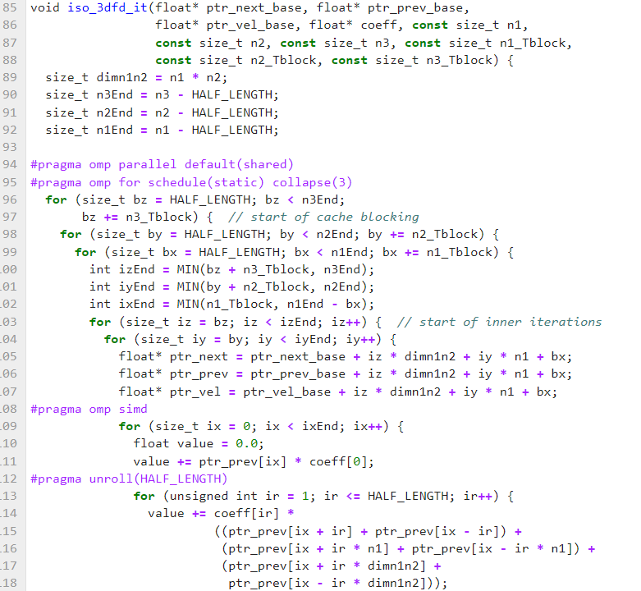
Intel® VTune™ Profiler
Performance Analysis for Applications & Systems
Intel® VTune™ Profiler
Example: 3D Isotropic Acoustic Finite-Difference Wave Equation
Focus on this section of code!

Slide 8
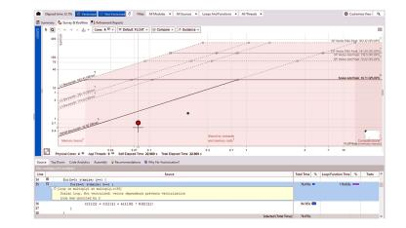
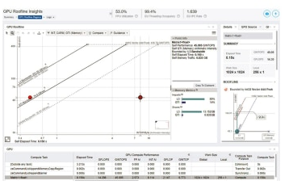
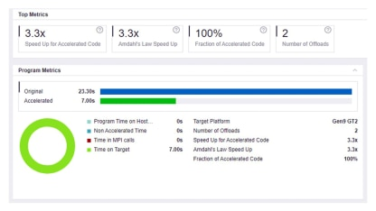
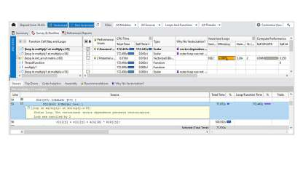
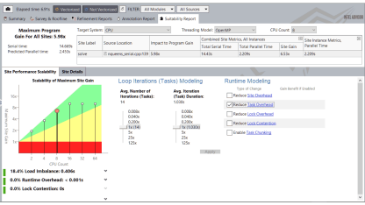
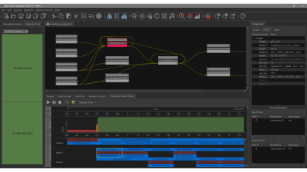
Intel® Advisor
Intel® Advisor
Roofline Analysis for CPUs
Roofline and Performance Insights for GPUs
Offload Modeling
Vectorization Optimization
Thread Prototyping
Flow Graph Analyzer

Slide 9
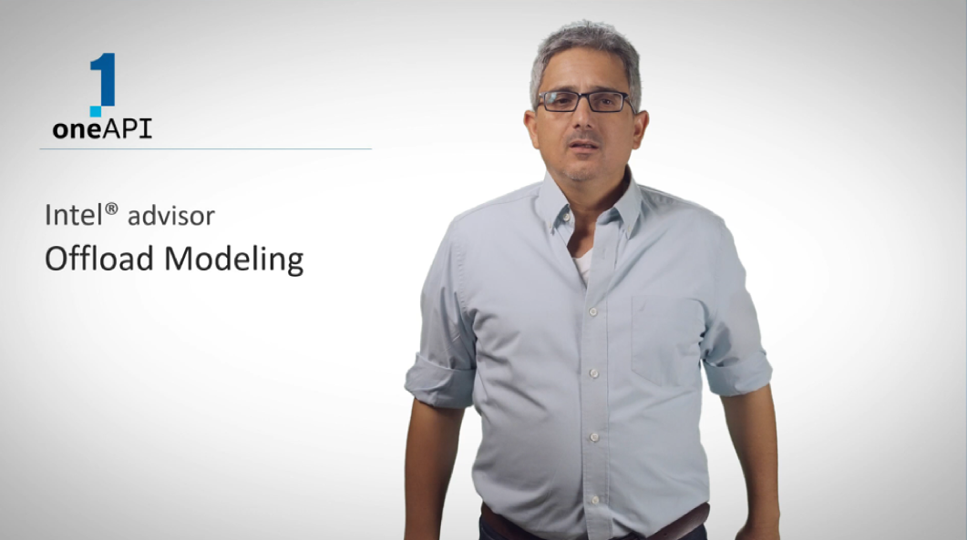
Intel® Advisor Offload Modeling
https://www.youtube.com/watch?v=Clg4f9EI2vY
Intel® Advisor User Guide

Slide 10
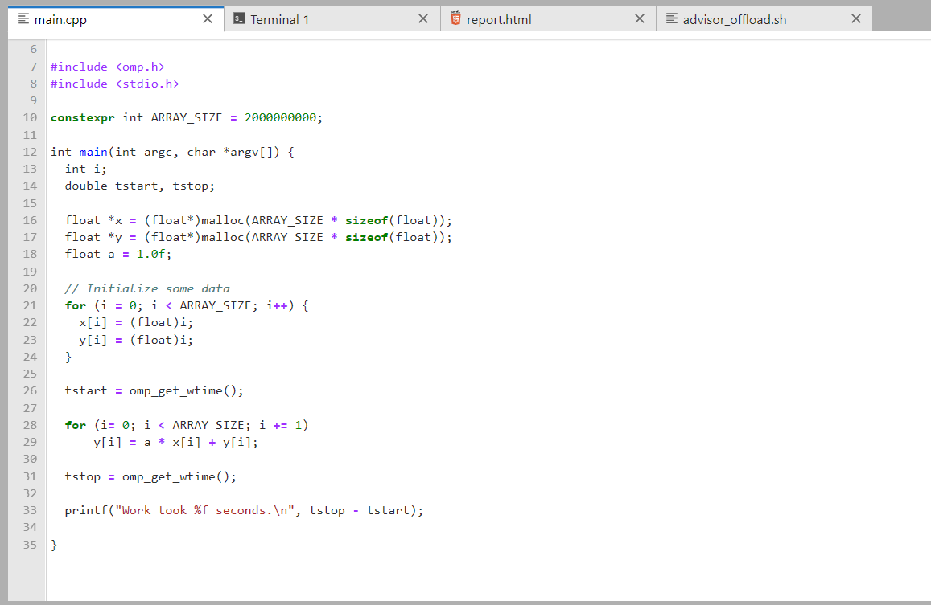
Intel® Advisor Offload Modeling - Example
SAXPY (Single-Precision A·X + Y)

Slide 11
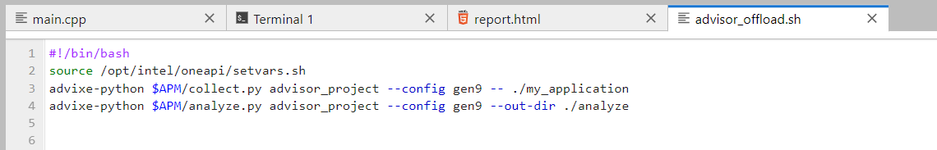

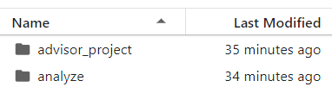
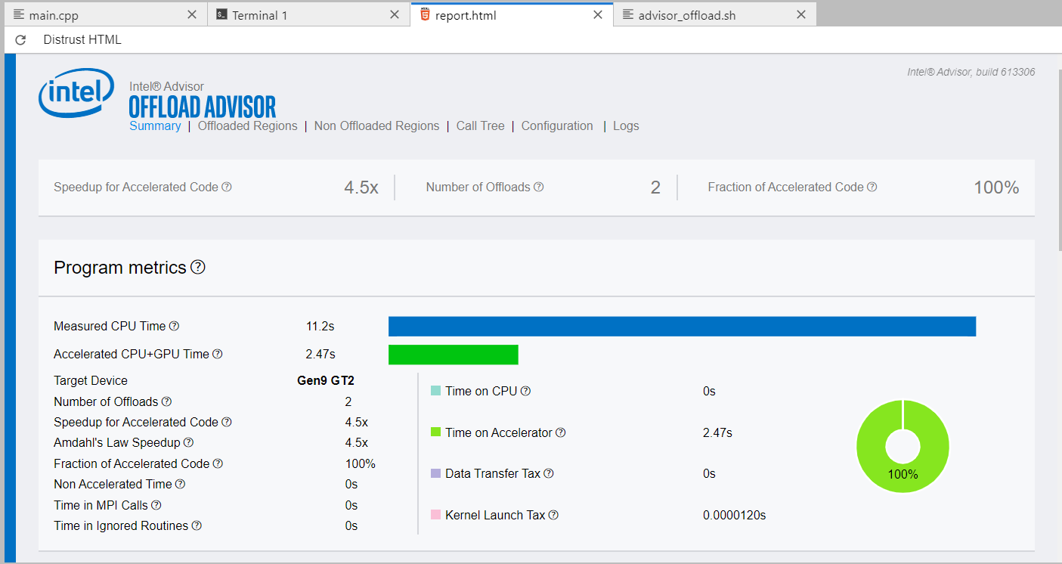
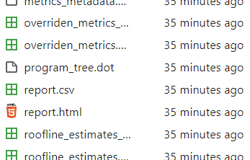
Intel® Advisor Offload Modeling - Example
SAXPY (Single-Precision A·X + Y)

Slide 12
Intel® Advisor Offload Modeling - Example
SAXPY (Single-Precision A·X + Y)
click to interactively watch the results

Slide 13
Intel® Distribution for GDB*
Quickly Debug Parallel and Multithreaded Code
Intel® Distribution for GDB*
The Intel® Distribution for GDB* application debugger is a companion tool to Intel® compilers and libraries.
It delivers a unified debugging experience that allows you to efficiently and simultaneously debug cross-platform parallel and threaded applications developed in Data Parallel C++ (DPC++), C, C++, OpenMP*, SYCL*, or Fortran.
Achieve full control over running applications, including breakpoints and single stepping.
Debug in a single session across CPU and GPU code to quickly examine variables, read/write memory and registers, and inspect the hardware state when the application is suspended.

Slide 14
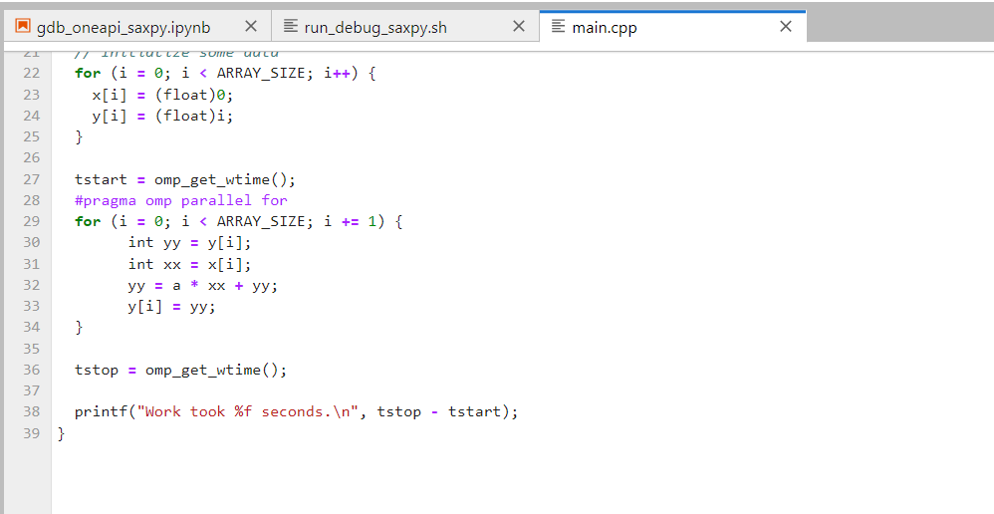
Intel® Distribution for GDB* - Example
Intel® Distribution for GDB*

Slide 15
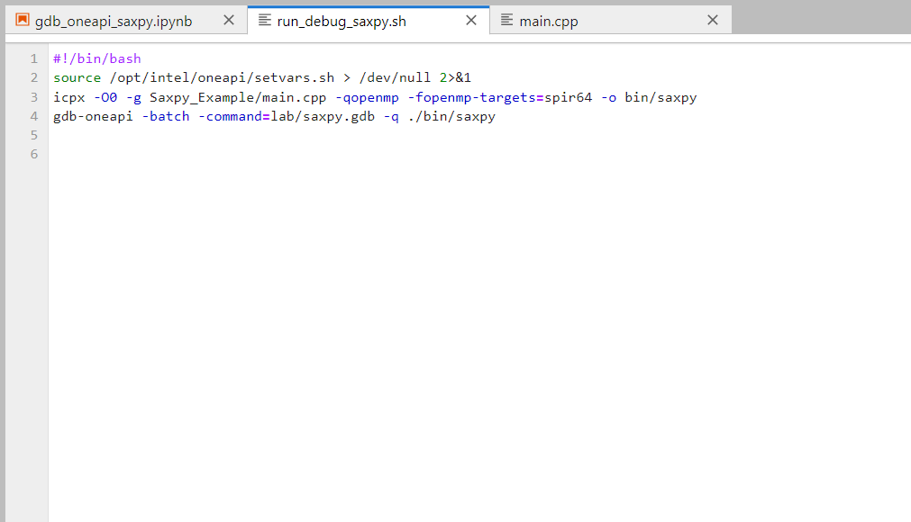
Intel® Distribution for GDB* - Example
Intel® Distribution for GDB*

Slide 16
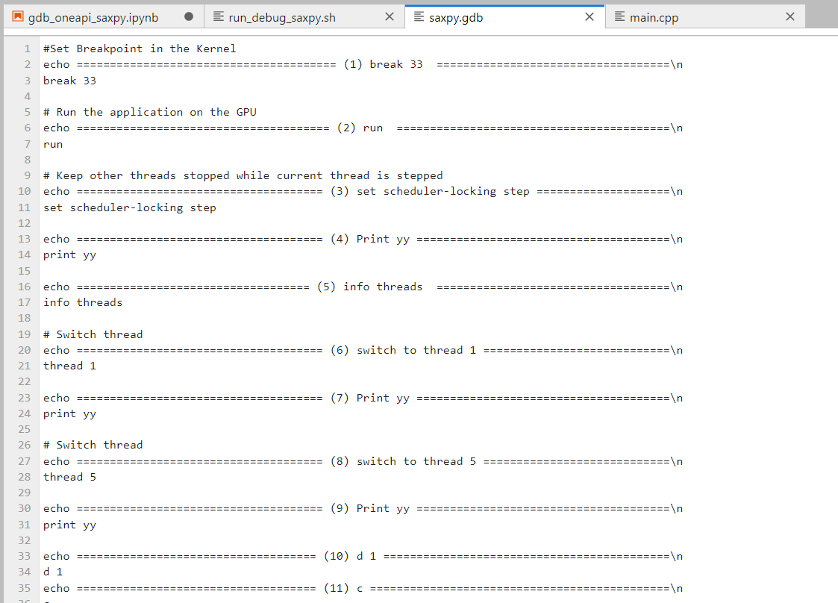
Intel® Distribution for GDB* - Example
Intel® Distribution for GDB*

Slide 17
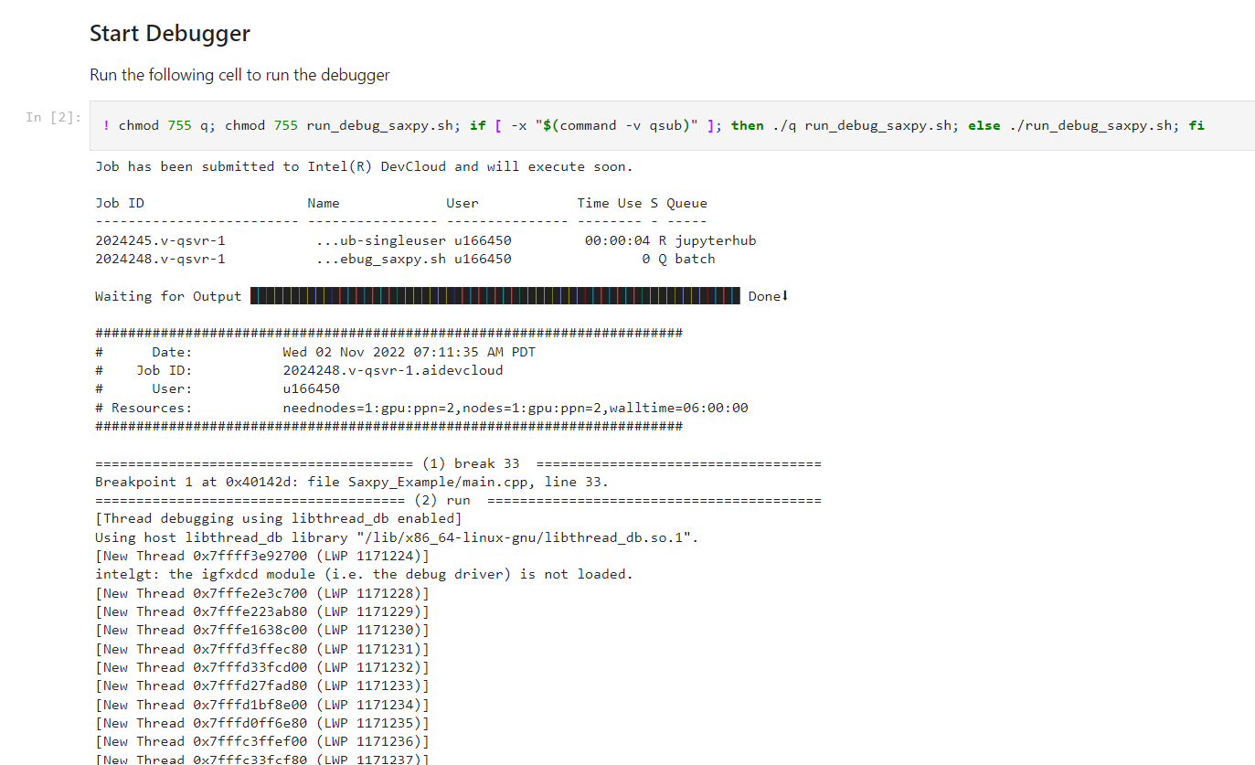
Intel® Distribution for GDB* - Example
Intel® Distribution for GDB*
click to watch the full output

Slide 18
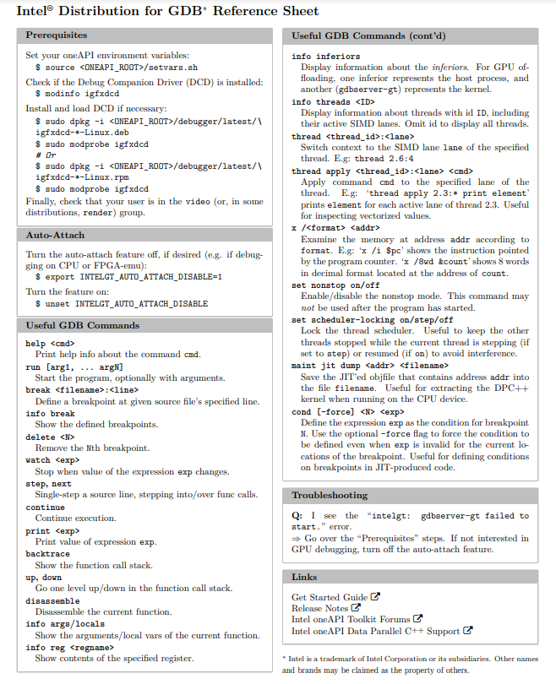
Intel® Distribution for GDB* (reference sheet)
https://www.intel.com/content/www/us/en/develop/download/gdb-reference-sheet.html

Slide 19
Intel® Inspector
Solve Memory and Threading Problems Early
Intel® Inspector
Memory errors and nondeterministic threading errors are difficult to find without the right tool.
Intel® Inspector is designed to find these. It is a dynamic memory and threading error debugger for C, C++, and Fortran applications that run on Windows* and Linux*.
Save time: simplify the diagnosis of difficult errors by breaking into the debugger just before the error occurs.
Save effort: use your normal debug or production build to catch and debug errors. Check all code, including third-party libraries with unavailable sources.

Slide 20

Intel® Inspector
Solve Memory and Threading Problems Early
https://www.intel.com/content/www/us/en/developer/videos/introduction-to-intel-inspector.html

Slide 21
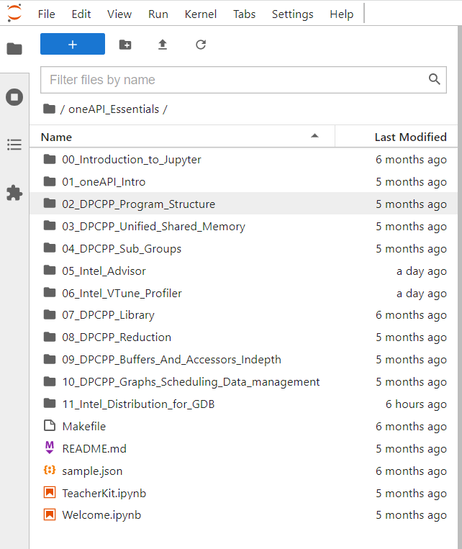
oneAPI_Essentials on your Intel DevCloud
Explore examples & how to use oneAPI tools on your Intel DevCloud

Slide 22
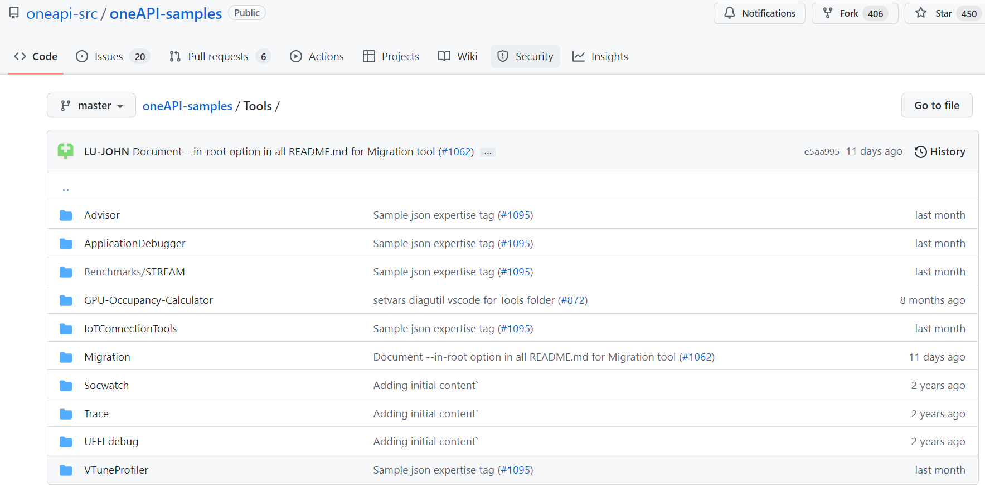
oneAPI-samples on GitHub
https://github.com/oneapi-src/oneAPI-samples/tree/master/Tools

Slide 23
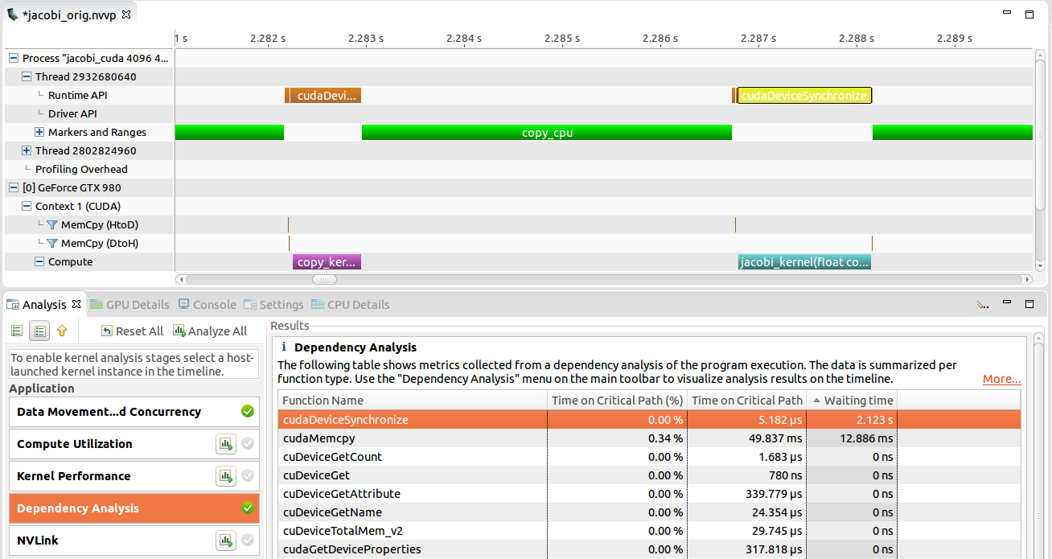
CUDA Toolkit: NVProf (supports OpenMP)
Nvidia Profiler User's Guide
From: Nvidia profiler User’s Guide https://docs.nvidia.com/cuda/profiler-users-guide/index.html

Slide 24
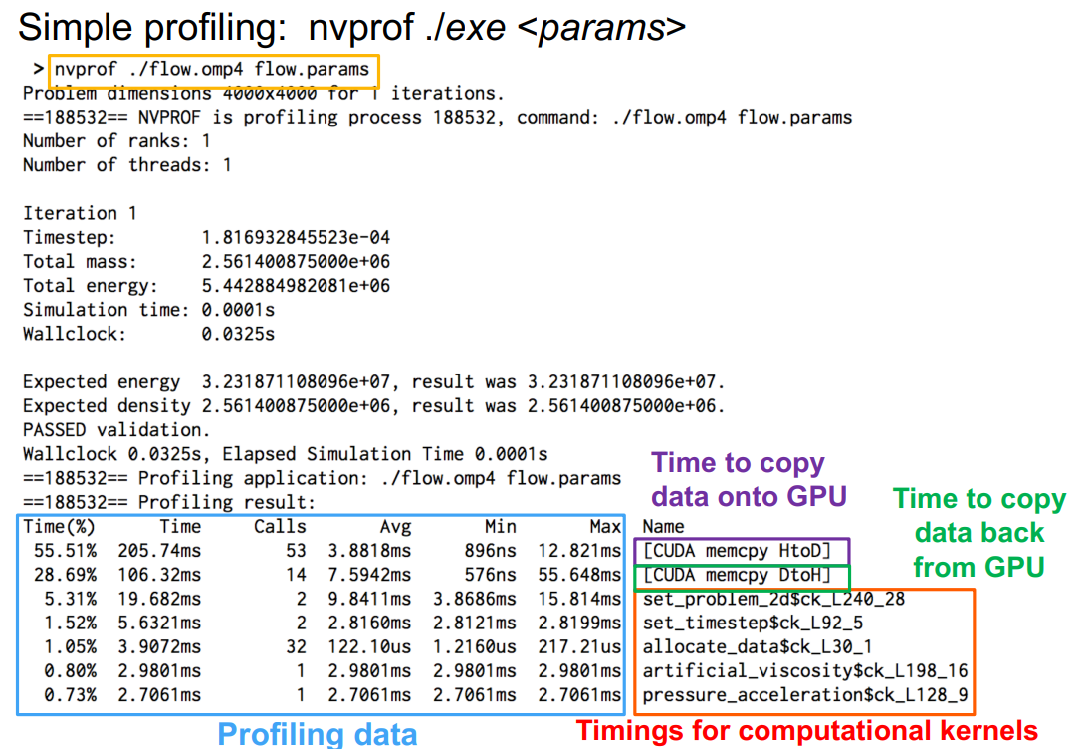
CUDA Toolkit: NVProf (supports OpenMP)
From: Programming your GPU with OpenMP: https://openmpusers.org/wp-content/uploads/uk-openmp-users-2018-OpenMP45Tutorial_new.pdf

Slide 25
What would you do?
POV: You iterate (even serially) through a 2D-matrix (in C) and you do not understand why performance is poor…
int i, j;
for (i = 0; i < n; i++) {
for (j = 0; j < n; j++){
matrix[j][i] = 0;
}
}
If you analyze with VTune (for example), what might you find out?

